Slide 1
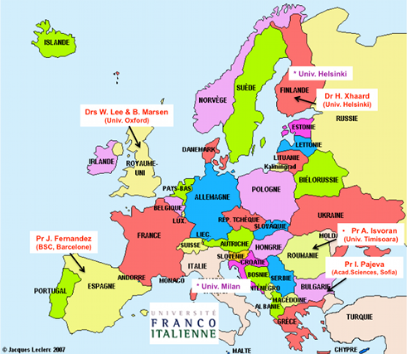
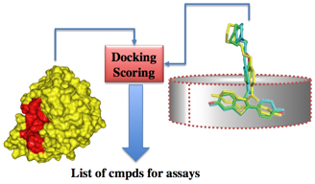
WHY THIS COURSE ISDD ?
The program « in silico Drug Design » - Design of Bioactive Molecules and – Modelling of Macromolecules , offer a solid interdisciplinary formation at the interface of biology, chemistry and computer science. Unique in France and in Europe, the program provides to students essential skills for in silico research on therapeutic molecules and computational modeling of macromolecules. The ISDD program respond to a demand from the private sector (pharmaceutical companies, biotechnology and public health) and the academic sector to train students in this emerging field of research.
INTERNATIONAL ASPECT
One or two semesters can to be performed abroad:
one semester of courses can be offered in Italy at the University of Milan and one semester internship can be performed abroad (mobility support : Erasmus grant, grant UFI, master's scholarships program-MIEM,…).
*International specialists offer high level courses.
CONTACTS
Coordinator of courses : Pr A-C. Camproux
anne.camproux@univ-paris-diderot.fr
Co-responsible :
M1 : Pr O. Taboureau olivier.taboureau@univ-paris-diderot.fr
Administrative Secretariat - Univ. Paris
Magali Jeanson : magali.jeanson@univ-paris-diderot.fr
University Paris Diderot - Paris 7
UFR Sciences du Vivant- Lamarck B
35, rue Hélène Brion 75013 Paris - France
Field Sciences and Technology
Master Bioinformatics
Course« In Silico Drug Design - Macromolecules»
Course « In Silico Drug Design - Bioactive Molecules»
University Paris
UFR Sciences du Vivant
Lamarck A, Case 7113
35 rue Hélène Brion 75205 PARIS CEDEX 13
FRANCE
Web site : http://isddteach.sdv.univ-paris-diderot.fr/
Master Bio-Informatics
Program
In Silico Drug Design
(ISDD)
« Professional or research course »
Private companies participating in the formation
International partnerships :
- University Degli Studi de Milan
University of Helsinki
University of Copenhagen
- University of Barcelona, …
C.G-22/01/2020
Site Web : http://isddteach.sdv.univ-paris-diderot.fr/

Slide 2
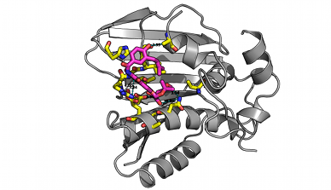
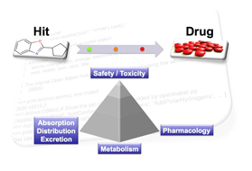
AIMS
These courses ISDD «in silico Drug Design» of the Bio-Informatics Master, provides training in all tasks related to the «Drug Discovery» process using in silico approaches, from theoretical to applications (for example, virtual screening of therapeutic targets, drug safety…).
It offers to students training in chemical biology based on the fundamental principles of chemistry, biochemistry, biophysics, pharmacology, molecular medicine, information technology, bioinformatics and biostatistics.
Interdisciplinarity is based on two French academics formations (chemoinformatics master of Strasbourg and Biology-computing master of Paris 7), and the participation of private companies and international experts from several countries.
STUDENT ELIGIBILITY
These courses ISDD «in silico Drug Design» of the Bioinformatics Master, welcomes students from various training : chemistry, biochemistry, biology, medical and pharmaceutical sectors and engineering schools applied to Life Sciences.
JOB OPPORTUNITIES
The formation ISDD train professionals in private and public sectors in France but also in Europe, using in silico approaches in the field of therapeutic innovation and / or turns towards developing pharmacological molecules. Over 80% of students find a job directly (CDD, CDI or PhD) after the Master.
Activity Sectors : Chemical and Pharmaceutical Industry / Academic research / public research center and private / Platforms in chemoinformatics, screening, Drug Design, bioinformatics.
ORGANISATION
This formation «in silico Drug Design» is based on collaboration between Paris , Strasbourg, universities and the University Degli Studi of Milan. Many Erasmus grants have been signed with other European universities for internships.
It offers two international courses, each with a semester abroad
The program ISDD-Macromecules , «Modelling of Macromolecules» , with the first semester at Paris Diderot, following by a second semester at Paris-Diderot or degli Studi di Milano University, the third semester at Paris Diderot and the last semester of internship which should preferably be done abroad.
2) The program ISDD-Bioactive Molecules «Design of Bioactive Molecules», with one semester at University of Strasbourg, one semester at University degli Studi di Milano then at Paris-Diderot University and last one semester internship in France or abroad.
This program gives the opportunity to the students to obtain two diplomas: The master Bioinformatics course “In silico Design of bioactive molecules” from the universities Paris Diderot and Strasbourg and the “Laureate Magistrale in Science Chimiche” from the university degli Study di Milano
PROGRAM
FIRST YEAR (M1) SEMESTER 1
SEMESTRE 2
SECOND YEAR (M2)
SEMESTER 3 - University of Paris
(common to the two courses)
DRUG DESIGN & SCREENING
- UE Data Analysis in Drug Design (8 ECTS)
- UE Molecular & drug analysis and dynamics (7 ECTS)
- UE High throughput screening : "Structure and ligand based”* (5 ECTS)
- UE Analysis of the space of molecules (4 ECTS)
UE Preparation for research in Drug Design (6 ECTS)
* From 30% to 80% of courses in English
University Paris
Course « ISDD-Macromolecules »
University of Strasbourg
Course « ISDD-Bioactive Molecules »
OR
Chemoinformatic en Drug Design UE Fundamentals in Biochemestry and Biostatistics (7 ECTS) UE Programming and mathematical tools (9 ECTS) UE Pratical and in depth study (8 ECTS) UE Chemistry orientation (6 ECTS) | Chemoinformatic - UE Methodology (10 ECTS) - UE Molecular modeling (8 ECTS) - UE Chemoinformatic (10 ECTS) - UE language (2 ECTS)
University Paris
Course « ISDD-Macromolecules »
University of Milano
Course « ISDD-Bioactive Molecules »
OR
- UE Advanced fundamentals in biophysics and data analysis (6 ECTS) - UE Macromolecules modelling orientation (18 ECTS) (dynamics moleculr, protein-protein docking, structural bioinformatics, drug design) - UE Internship professionalisation (6 ECTS) | - UE Programming in C * (6 ECTS) - UE Structural biology and enzymology* (6 ECTS) - UE Medicinal Chemistry* (6 ECTS) - UE Simulation, modelling, biomolecules* (6 ECTS) - UE Bioactive molecules (6 ECTS)
COURSE « ISDD-MACROMOLECULES »
(possibility de parcours en alternance)
Course «ISDD-BIOACTIVES MOLECULES »
(possibility of double diploma)
Semester 1
University Paris (Pr O. Taboureau)
Chemoinformatic in Drug Design
Semester 1
University of Strasbourg
(Pr A. Varnek/Dr G. Marcou)
Chemoinformatic
ou
Semester 2
University Paris
(Pr O. Taboureau)
Macromolecules
Semester 2 *
University Degli Studi de Milan
(Pr L. Belvisi/Pr S. Pieraccini)
Bioactives Molecules
SEMESTER 4 - TRAINING PERIOD (6 mois)
ou
(in UK, Finland, France, Sweden, Norway, Spain, Bulgaria, Italy, Danemark, Korea,…)
For the course « ISDD- Macromolecules » the internships will take place in priority abroad
Training projects in private or academic, abrod or in France | Training projects in academic or private
Semester 3
University Paris
(Pr A-C. Camproux)
Drug Design & screening
Semester 4 *
Training period abroad
(Pr A-C. Camproux)
In U.K., Finland, Italy, Sweden, Norway, Danemark, Bulgaria, Australia, Korea, EU..
Semester 4
Training period
(Pr A-C. Camproux)
* Opportunities of Erasmus grants

