Slide 1
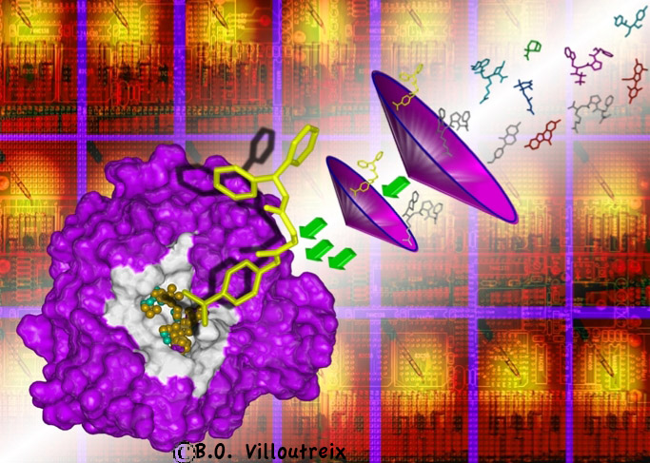
http://isddteach.sdv.univ-paris-diderot.fr/
Bio-Informatics Master /
In Silico Drug Design
Coordinator : Pr A-C. Camproux
anne-claude.camproux@univ-paris-diderot.fr
Bio-Informatics MASTER IN SILICO DRUG DESIGN (ISDD)
Course MACROMOLECULES
Parcours recherche ou alternance
https://bit.ly/2IuD1Km
- University of de Paris :
Pr O. Taboureau (M1) Pr A-C. Camproux (M1 et M2)
Course MOLECULES BIOACTIVES
Possibilité Double Diplôme
https://bit.ly/2LUb9Bz
- University of Paris :
Pr O. Taboureau (M1) Pr A-C. Camproux (M1 et M2)
- Univ. Strasbourg : (Semester 1)
Dr G. Marcou & Pr A. Varnek
- Univ. Degli studi de Milan : (Semester 2)
Pr S. Pieraccini, & Pr L. Belvisi

Slide 2
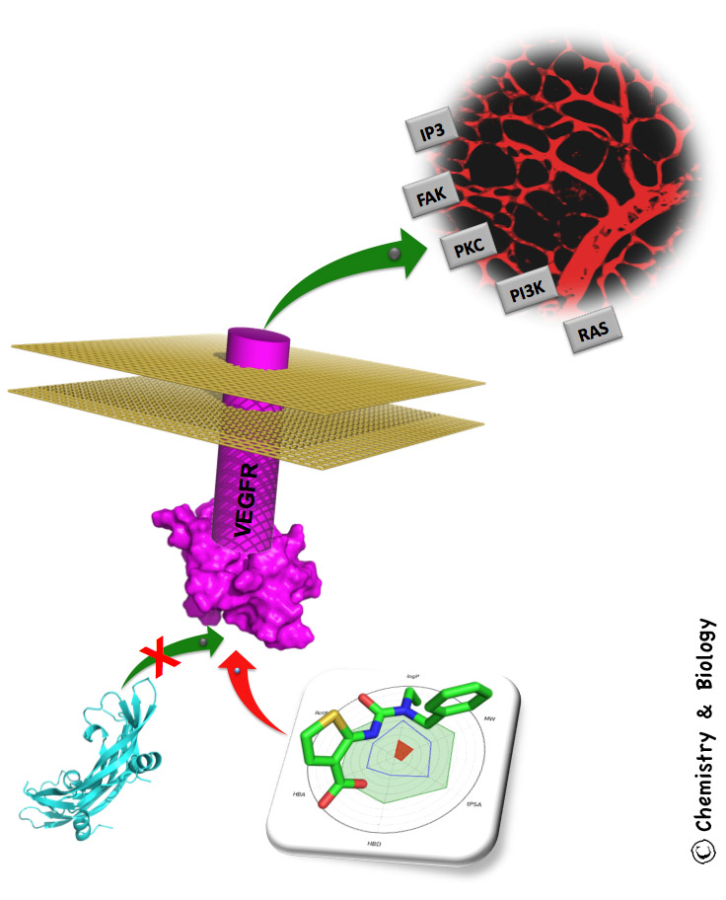
« - Multidisciplinary and multi-site training, outstanding international contributions in the field of computational sciences and therapeutic innovation.
- Strong partnerships with key universities and pharmaceutical industries.
Involvement of many professional
experts. » (AERES 2013)
Job opportunities?
With this master degree, you will have career opportunities in many private and public organizations working in the field of health and therapeutic innovation assisted by computers at the interface of chemical biology.
Our international training facilitates worldwide job applications.
International Master
Semesters abroad, 30 to 50% training in english, International experts participation.
How to apply inscriptions?
https://bit.ly/37dpgu5
How to propose an internship?
https://bit.ly/37dpgu5

